Slide 1
Desarrollo de aplicaciones
Arquitecturas Emergentes Clean Code
Cristian López – Juan Pablo Delpino

Slide 2
Parte 1
Clean Code – Reglas básicas
Radiografía de un método.
Nombres significativos.
Nombres pronunciables.
Evitar codificaciones.
Sin efectos secundarios.
Vicios (copy/paste)
Comentarios sin sentido..

Slide 3
Parte 2
Code Smells
Duplicated code
Long method
Long class
Long parameter list
Divergent change
Feature envy
Data clumps
Primite obsession
Switch Statements
Laze class
Message chains
Dark intention
Data class

Slide 4
Parte 3
Refactoring
Explain Method
Table Driven
Introduce Explaining Method
Split Temporary Variable
Remove assignments to parameters
Extract Class
Decompose Conditional
Consolidate conditional expression
Consolidate duplicate conditional fragments
Remove control flag
Replace nested conditionals with guard clauses
Replace parameter with explicit methods (selector argument)
Introduce parameter object
Replace error code with exception
Replace exception with test
Replace primitive with object

Slide 5
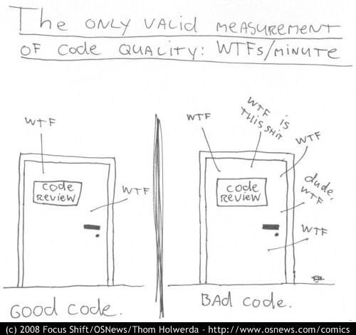
Clean code
Notes:
What the fuck / minutes

Slide 6
Clean code
Simple.
Expresivo.
0% Duplicidad.
Notes:
What do we understand for clean code?
--
It must be simple for reading and to understand. If I understand it I can improve it, change it, extend it.
--
It’s about setting good names.
MEANINGFUL names.
Let’s take the time to choose good names!
Without any surprise.
Clean code can be read, and enhanced by a developer other than its original author.
--
It “says the things” once.

Slide 7
Arquitectura Emergente
Clean Code
We are @authors
import java.util.List;
/**
* @author Cristian
*/
public class CycloDetector {
...
...
...
}
Notes:
(The @author keyword comes from javadoc)
We are authors, and the most important thing about that is that we have readers!
We are responsible for communicating well with our readers. They will judge us ☺.
We don’t write code for the machine, but for humans (programmers).

Slide 8
Arquitectura Emergente
Clean Code
~10:1
Notes:
That’s the ratio of time spent reading vs. writing.
Making it easy to read actually makes it easy to write.

Slide 9
Clean Code – Radiografía de un método

Slide 10
Clean Code – Radiografía de un método
Notes:
If possible, we want methods like this, simple and easy to understand.

Slide 11
Clean Code – Nombres significativos
int h; //hours since game started
int hoursSinceGameStarted;
Notes:
“h” is a noninformative name!
“h” provide no clue to the author intention.

Slide 12
Clean Code – Nobres significativos – Qué y no Cómo
boolean linearSearchFor(Object element)
boolean includes(Object element)
Notes:
What vs How (again)
The first one reveals implementation and not the intention! It does not communicate the important thing about it (the reader won’t be interested in how it does it, but what it does).
The second one reveals its intention more clearly.
------------
What are the benefits of this?
- Polimorphism (LinearSearch is just one way of implementing the Include, but not the only one).
- Remove useless information to the reader.
TIP - One way to verify if the name we have just set is on the ‘What’ or ‘How’ side:
Think about other possible implementation. Is the name still valid?

Slide 13
Clean Code – Nombres pronunciables
public DateFormatContainer(String dfStr) {
this.dfStr = dfStr;
}
public DateFormatContainer(String dateFormatString){
this.dateFormatString = dateFormatString;
}
Notes:
dfStr cannot be pronounced. If you cannon pronounce, you cannot talk and discuss about it.
dateFormatString is quite better.

Slide 14
Clean Code – Evitar codificaciones
String m_description;
String description;
Wheel[] _wheels;
Wheel[] wheels;
int iSize;
int size;
Boolean bBusy;
Boolean busy;
Notes:
Hungarian notation has no sense nowadays, as we have a compiler and an IDE that remembers and enforce the types.
If we write small classes and short functions, people can see the point of declaration of each variable they’re using.
They make it harder to read.
If we change the type, we will need to change also the name!

Slide 15
Clean Code – Intención explicita
Si es true es RO si no RW
File file = new File("pref.txt", true);
File file = File.newReadOnly("pref.txt");
Notes:
Talk about flag arguments.
For example:
file := File new (‘pref.txt’, true) // What’s that True??
Vs
file := File newReadOnly(‘pref.txt’) //quite more clear!

Slide 16
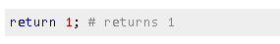
Clean Code – Comentarios sin sentido
//if red is true then if(isRed())
// Add one i++;
Notes:
Los comentarios tienen sentido si agregan valor al código, pero tener mucho comentarios y documentación .. Muchas veces es indicador de un código pobre y poco expresivo. Es preferible menos documentación coloquial y mas esfuerzo el codear de manera expresiva en código autodocumentado

Slide 17
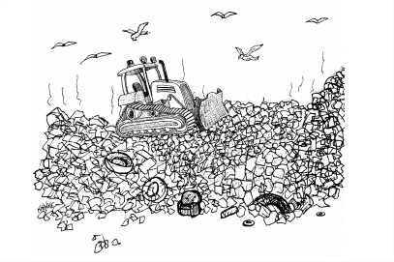
Code Smells

Slide 18
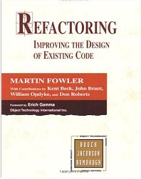
Code smells
Código o diseño al menos sospechoso
define mas de 40 (diseño/código)
Levantan alertas para inspeccionar código.
Como los patrones de diseño, crean un “diccionario” para comunicarnos de manera mas efectiva
Radiografía de code smells (los mas comunes)
Notes:
Mostramos solo algunos y en formato de radiografía ya que en la tercera parte veremos algunos refactors como para mitigar estos problemas

Slide 19
Duplicated Code
Notes:
Es el smell padre de todos…

Slide 20
Long method

Slide 21
Large class
Notes:
Y sus variantes, God Class, Brain Class (ver OO Metrics, para entender las diferencias)

Slide 22
Long parameter list
xxxxxxx ( )

Slide 23
Divergent change
Notes:
Una misma clase se ve afectada, solo en partes por cambios diferentes.
Pasa cuando una clase tiene mas de una responsabilidad.

Slide 24
class CapitalCalculator {
...
public double capital(Loan loan) {
if (loan.getExpiry() == null && loan.getMaturity() != null)
return loan.getCommitment()*loan.duration()*loan.riskFactor();
if (loan.getExpiry() != null && loan.getMaturity() == null) {
if (loan.getUnusedPercentage() != 1.0)
return loan.getCommitment() * loan.getUnusedPercentage() *
loan.duration() * loan.riskFactor();
else
return (loan.outstandingRiskAmount()*loan.duration()
* loan.riskFactor())
+ (loan.unusedRiskAmount() * loan.duration()
* loan.unusedRiskFactor());
}
return 0.0;
}
...
}
Feature envy
Notes:
El método capital esta mas interesado en las cosas de loan que en las cosas propias del objeto en el que vive.

Slide 25
Data clumps
method1( )
method2( )
method3( )
method4( )
Notes:
Los mismos objetos son pasados en diferentes métodos.
El código nos pide un nuevo objeto!

Slide 26
Primite obsession
double money;
String phone;
String zipCode;
String password;
Notes:
La $$ es plata!! En sistemas donde es necesario manipular $$ es necesario modelarlo ya que obligatoriamente hay que comenzar a realizar conversiones y manejo de unidad.
Lo mismo con zipcode y phone!

Slide 27
Lazy class
Notes:
No hace nada interesante. Por ahí le fueron sacando cosas por distintos refactorings, y ya no aplica mas.
Ojo que no es que está mal, si no que levanta al alerta para chusmear. De hecho hay un patron de diseño que habla de esto.

Slide 28
Message chains
()
()
()
()
()
Notes:
También conocidos como train wrenches.
Law of demeter. Solo habla con tus amigos cercanos (no mas de 2).
Cuando se utiliza frameworks, es muy comun caer en este tipo de patrones de código y es inevitable. Al menos el código que se pueda, deberíamos evitar hacerlo ya que trae como consecuencia alto acoplamiento y perdida de encapsulamiento.

Slide 29
Data Class
Cuenta
Código
Persona
Categoría
Rubro
contactos
getCodigo()
getPersona()
setPersona()
getCategoria()
setCategoria()
getRubro()
setRubro()
getContactos()
setContactos()
Notes:
Seguro que son manipuladas por otras.
Si hay data class, hay feature envy.

Slide 30
Dark intention
public int m_otCalc() {
return (iThsWkd * iThsRte
+
(int) Math.round(0.5 * iThsRte
* Math.max(0, iThsWkd
- 400)));
}
Notes:
What does this method do?

Slide 31
Dark intention (ejemplo 2)
// Checks if I can exit from the application
public Boolean skipValidation(Boolean status) {
boolean skipValidation = true;
if (status.compareTo(Boolean.FALSE) != 0)
skipValidation = false;
return skipValidation;
}
public Boolean skipValidation(Boolean status) {
return !status;
}
Notes:
Dark intention.

Slide 32

Refactoring

Slide 33
Comentarios ?
if ((platform.toUpperCase().indexOf("MAC") > -1)
&& (platform.toUpperCase().indexOf("IE") > -1)
&& wasInitialized()
&& resize > 0) {
someCode();
}
otherCode();
Notes:
What does this code tells to you?
What we spect to hear:
Different abstraction levels in the code.
Non declarative conditions.
Solution:
Explaining Methods!!!

Slide 34
Explaining Method
Notes:
Logic expressions could be very hard to read and understand.
This refactor is centered on the code reader, we help him understand what code does and hide the algorythm steps.
Also we could define explaining variables, but explaining methods are even better.

Slide 35
Explaining Method
if (isMacOs()
&& isIEBrowser()
&& wasInitialized()
&& wasResized()) {
someCode();
}
otherCode();
if (isPlatformSupported()
&& wasInitialized()
&& wasResized()) {
someCode();
}
otherCode();
Notes:
Also we could use an explaining methods to join two related explaining methods and raise the abstraction level even more.

Slide 36
Explaining Method
boolean wasResized() {
return resize > 0;
}
boolean isIEBrowser() {
return platform.toUpperCase().indexOf("IE") > -1;
}
boolean isMacOs() {
return platform.toUpperCase().indexOf("MAC") > -1;
}
boolean isPlatformSupported() {
return isMacOs() && isIEBrowser();
}
Notes:
See how this code is very easy to understand.
Explaining methods. Only one functionality and explained by their name.

Slide 37
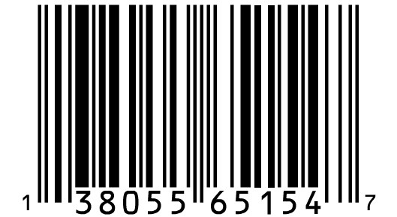

Slide 38
Comentarios?
if (inputCharacter < Character.SPACE_SEPARATOR) {
characterType = CharacterType.Control;
} else if (inputCharacter == ' ' || inputCharacter == ','
|| inputCharacter == '.' || inputCharacter == '!‘
|| inputCharacter == '(' || inputCharacter == ')'
|| inputCharacter == ':' || inputCharacter == ';'
|| inputCharacter == '?' || inputCharacter == '_'
|| inputCharacter == '-') {
characterType = CharacterType.Puntuaction;
} else if ('0' <= inputCharacter && inputCharacter <= '9') {
characterType = CharacterType.Digit;
} else if (('a' <= inputCharacter && inputCharacter <= 'z')
|| 'A' <= inputCharacter && inputCharacter <= 'Z') {
characterType = CharacterType.Letter;
}
Notes:
The same… explaining methods tell what the code does hiding how it works… another programer should understand code without seeing what explaining methods hide.

Slide 39
Fix.
if (isControl(inputCharacter)) {
characterType = CharacterType.Control;
} else if (isPuntuaction(inputCharacter)) {
characterType = CharacterType.Puntuaction;
} else if (isDigit(inputCharacter)) {
characterType = CharacterType.Digit;
} else if (isLetter(inputCharacter)) {
characterType = CharacterType.Letter;
}
Notes:
See how this code tells a lot of what it does hiding how it does it.
We could rearrange the if sentences (the most used above) to gain performance.

Slide 41
Comentarios ?
double getDistanceTravelled (int time) {
double result;
double acc = primaryForce / mass;
int primaryTime = Math.min(time, delay);
result = 0.5 * acc * primaryTime * primaryTime;
int secondaryTime = time - delay;
if (secondaryTime > 0) {
double primaryVel = acc * delay;
acc = (primaryForce + secondaryForce) / mass;
result += primaryVel * secondaryTime + 0.5
* acc * secondaryTime * secondaryTime;
}
return result;
}
Notes:
See this code.
What we want to hear:
Temporary variable used with different purposes. This is a very common smell and it makes the real purpose of the variable very confusing.
Also explaining methods could clear some doubts here.

Slide 42
Split Temporary Variable
Notes:
A temporary variable will have only one responsability.
More than that it gets confusing.
It will only be set one time. (Excluding looping variables or collecting parameters)

Slide 43
Split Temporary Variable
double getDistanceTravelled(int time) {
double result;
double primaryAcc = primaryForce / mass;
int primaryTime = Math.min(time, delay);
result = 0.5 * primaryAcc * primaryTime * primaryTime;
int secondaryTime = time - delay;
if (secondaryTime > 0) {
double primaryVel = primaryAcc * delay;
double secondaryAcc = (primaryForce + secondaryForce)/mass;
result += primaryVel * secondaryTime + 0.5
* secondaryAcc * secondaryTime * secondaryTime;
}
return result;
}
Notes:
One temp variable per use!!

Slide 44
Split Temporary Variable
public double getDistanceTravelled(int time) {
if (secondaryTime(time) > 0) {
return primaryDistanceTravelled(time)
+ secondaryDistanceTravelled(time);
}
return primaryDistanceTravelled(time);
}
Notes:
Even better with some extract methods.

Slide 46
Comentarios ?
int discount(int value, int quantity) {
if (value > 50) {
value -= 2;
}
if (quantity > 100) {
value -= 5;
}
return value;
}
Notes:
What we want to hear:
Using parameter as temp variable!!!!!

Slide 47
Remove assignments to parameters
Notes:
Java uses value parameters so the original variable shouldn’t be modiffied, but this generates a lot of confussion.
Parameters should be read only (we could use final markup).
May be a bug, from something that doesn’t know how java passes parameters.
Some languages allow devs to pass IN and OUT args.

Slide 48
Remove assignments to parameters
int discount(final int value, final int quantity) {
int discount = value;
if (value > 50) {
discount -= 2;
}
if (quantity > 100) {
discount -= 5;
}
return discount;
}
Notes:
Using a temp variable is the solution. We could even use explaining methods for the statements.

Slide 50
Comentarios ?
class Page {
private String[] lines;
private double widthNumber;
private String widthUnits;
private double heightNumber;
private String heightUnits;
public double area() {
double widthInches;
double heightInches;
widthInches = widthNumber *
((widthUnits.equals("mm"))? 25.4 : 1.0);
heightInches = heightNumber *
((heightUnits.equals("mm"))? 25.4 : 1.0);
return widthInches * heightInches;
}
}
Notes:
What we want to hear:
Something needs to be modeled, the class Page is managing internal uses of the len properties.
This is like we cast a long to int for ourselves, or we apply toUpper to a string on our own.
This is not our responsability!

Slide 51
Extract Class
Notes:
Whenever a class grows, it gets harder to understand all the responsabilities it’s adding to itself.
It’s better to delegate extra responsabilities in other classes.

Slide 52
Extract Class
class Page {
private String[] lines;
private Length width;
private Length height;
public Length area() {
return width.multipliedBy(height);
}
}
Notes:
Code refactored… very easy to read.

Slide 53
Extract Class
class Length {
private final double magnitude;
private final Unit unit;
public Length(Unit unit, double magnitude) {
this.unit = unit;
this.magnitude = magnitude;
}
private static Length newInInches(double magnitudeInInches) {
return new Length(Unit.inches, magnitudeInInches);
}
public Length multipliedBy(Length aLength) {
return Length.newInInches(this.magnitudeInInches()
+ aLength.magnitudeInInches());
}
private double magnitudeInInches() {
return magnitude;
}
private double magnitudeInMM() {
return magnitude * Unit.mmFactor();
}
}
Notes:
Extracted class.
Very clean and cohesive methods

Slide 55
Comentarios ?
double chargeFor(Date date, int quantity) {
double totalCharge = 0;
if (date.before(WINTER_END)&& date.after(WINTER_START)){
totalCharge = quantity * WINTER_RATE
+ WINTER_SERVICE_CHARGE;
} else {
totalCharge = quantity * NORMAL_RATE;
}
return totalCharge;
}
if !(date.before(WINTER_START) || date.after(WINTER_END)){
Notes:
What we want to hear:
Very difficult conditional expresions.
Very difficult to understand what it does.

Slide 56
Comentarios ?
public List<Element> nextFrom(int offset, int size) {
if (((offset + size) > (cacheOffset + cacheSize))
|| (offset < cacheOffset)) {
repopulateCache(offset, size);
}
return nextFromCache(offset, size);
}
Notes:
Method for a paginator that chaches results.
If logic needs an undestanding time… and also it’s in a different abstraction level than the rest.

Slide 57
Decompose Conditional
Notes:
Complex conditional expresions are guilty for the hard method understanding.
Extract method in conditional and parts.

Slide 58
Decompose Conditional
double chargeFor(Date date, int quantity) {
if (isAWinter(date)) {
return winterCharge(quantity);
}
return normalCharge(quantity);
}
double chargeFor(Date date, int quantity) {
return isAWinter(date) ?
winterCharge(quantity):normalCharge(quantity);
}
Notes:
Very easy to understand…

Slide 59
Decompose Conditional
private boolean isAWinter(Date date) {
return date.after(WINTER_START) && date.before(WINTER_END);
}
private double normalCharge(int quantity) {
return quantity * NORMAL_RATE;
}
private double winterCharge(int quantity) {
return quantity * WINTER_RATE + WINTER_SERVICE_CHARGE;
}
Notes:
Cohesive explaining methods ☺

Slide 60
Decompose Conditional
public List<Element> nextFrom( int offset, int size) {
if (cacheNeedsRePopulation(offset, size)) {
repopulateCache(offset, size);
}
return nextFromCache(offset, size);
}
boolean cacheNeedsRePopulation(int offset, int size) {
return requestIsUnderCacheWindow(offset, size)
|| requestIsOverCacheWindow(offset);
}
Notes:
Same abstraction level.
If I want implementation details I seek inside the method, if not, I save some time.

Slide 61
Decompose Conditional
boolean requestIsOverCacheWindow(int offset) {
return offset < cacheOffset;
}
boolean requestIsUnderCacheWindow(int offset,int size){
return (offset + size) > (cacheOffset + cacheSize);
}
Notes:
Cohesive explaining methods ☺

Slide 63
Comentarios ?
class TicTacToeGame {
boolean isGameOver() {
if (allPositionsAreFilled()) {
return true;
}
if (oneRowIsFilledByOnePlayer()) {
return true;
}
if (oneColumnIsFilledByOnePlayer()) {
return true;
}
if (oneDiagonalIsFilledByOnePlayer()) {
return true;
}
return false;
}
}
Notes:
What we want to hear:
A lot of conditionals with same exit (code duplicated? Maybe)

Slide 64
Comentarios ?
public double getRate() {
if (onVacation()) {
if (lengthOfService() > 10) {
return 1;
}
}
return 0.5;
}
Notes:
What we want to hear:
Too ifs to express 2 conditions… why 2 ifs?

Slide 65
Consolidate conditional expression
Notes:
Lots of branches finishing with same action. Use ANDs or Ors.

Slide 66
Consolidate conditional expression
boolean isGameOver() {
if (allPositionsAreFilled()
|| oneRowIsFilledByOnePlayer()
|| oneColumnIsFilledByOnePlayer()
|| oneDiagonalIsFilledByOnePlayer()) {
return true;
}
return false;
}
boolean isGameOver() {
return allPositionsAreFilled()
|| oneRowIsFilledByOnePlayer()
|| oneColumnIsFilledByOnePlayer()
|| oneDiagonalIsFilledByOnePlayer();
}
Notes:
Refactored.. (ORs)

Slide 67
Consolidate conditional expression
public double getRate() {
if (onVacation() && lengthOfService() > 10) {
return 1;
}
return 0.5;
}
public double getRate() {
return (onVacation() && lengthOfService() > 10) ? 1 : 0.5;
}
Notes:
Refactored… (AND)

Slide 69
Comentarios ?
public double finalPrice(double price) {
double total = 0;
if (isSpecialDeal()) {
total = price * 0.95;
changed();
} else {
total = price;
changed();
}
return total;
}
Notes:
What we want to hear:
Duplicated code!

Slide 70
Consolidate duplicate
conditional fragments
Notes:
Same code executing in two different branches.
Duplicated code is always a problem.

Slide 71
Consolidate duplicate conditional fragments
public double finalPrice(double price) {
double total = 0;
if (isSpecialDeal()) {
total = price * 0.95;
} else {
total = price;
}
changed();
return total;
}
Notes:
Refactored.. Moved duplicated code to one only place.

Slide 73
Comentarios ?
public boolean exist(String nameToFind) {
boolean found = false;
for (String name : names) {
found = found || name.equals(nameToFind)
}
return found;
}
Notes:
What we want to hear:
Control flag…

Slide 74
Remove control flag
Notes:
It happens when a programmer stands at the rule of imperative programming, that a function only has one and only one exit point.
In short methods, multiple exits are easy to understand.

Slide 75
Remove control flag
public boolean exist(String nameToFind) {
for (String name : names) {
if (name.equals(nameToFind)) {
return true;
}
}
return false;
}
Notes:
Refactored.. No control flag, replaced with return points.

Slide 77
Comentarios ?
double getPayAmount() {
double result;
if (isDead) {
result = deadAmount();
} else {
if (isSeparated) {
result = separatedAmount();
} else {
if (isRetired) {
result = retiredAmount();
} else {
result = normalAmount();
}
}
}
return result;
}
Notes:
What we need to here:
A lot of cyclomatic complex.
3 nested ifs in one method is a lot.

Slide 78
Replace nested conditionals
with guard clauses
Notes:
Unussual conditions of the happy road.
Nested statements are very difficult to follow.
Using Guard Clauses, we have the happy road and the unusual conditions.

Slide 79
Replace nested conditionals with guard clauses
double getPayAmount() {
if (isDead) {
return deadAmount();
}
if (isSeparated) {
return separatedAmount();
}
if (isRetired) {
return retiredAmount();
}
return normalAmount();
}
Notes:
Refactored..
See the guard clauses for unusual states.

Slide 80
Replace nested conditionals with guard clauses
double getAdjustedCapital_v1() {
double result = 0.0;
if (capital > 0.0) {
if (intRate > 0.0 && duration > 0.0) {
result = (income / duration) * ADJ_FACTOR;
}
}
return result;
}
Notes:
Another example..

Slide 81
Replace nested conditionals with guard clauses
double getAdjustedCapital_v2() {
if (capital <= 0.0) {
return 0.0;
}
if (intRate <= 0.0 || duration <= 0.0) {
return 0.0;
}
return (income / duration) * ADJ_FACTOR;
}
Notes:
Refactored… a step left (see next slide)

Slide 82
Replace nested conditionals with guard clauses
double getAdjustedCapital_v3() {
if (capital <= 0.0 || intRate <= 0.0 || duration <= 0.0) {
return 0.0;
}
return (income / duration) * ADJ_FACTOR;
}
Notes:
Applying consolidate conditionals… (And DeMorgan rules)
See all conditions in only one if statement….
Also we can apply explaining methods for each ☺

Slide 84
Comentarios ?
calculateWeeklyPay(true);
public int calculateWeeklyPay(boolean overtime) {
int overtimePay = 0;
int straightTime = Math.min(400, getHoursWorked());
int straightPay = straightTime * getHoursRate();
if (overTime) {
int overTimeCount = Math.max(0,getHoursWorked()-straightTime);
double overtimeRate = overtime ?1.5 : 1.0*getHoursRate();
overtimePay = (int)Math.round(overTime*overtimeRateCount);
}
return straightPay + overtimePay;
}

Slide 85
Replace parameter with explicit methods
Notes:
Group of parameters always together in different methods.
It means something is missing in the model.

Slide 86
Replace parameter with explicit methods
public int straightPay()
public int overtimePay()
Notes:
Actually, they are two different methods.

Slide 88
Comentarios ?
interface ClaimsRepository {
List<Claim> claimsReceivedIn(Date start, Date end);
List<Claim> claimsApprovedIn(Date start, Date end);
List<Claim> claimsRejectedIn(Date start, Date end);
}
Notes:
What we need to hear:
Data clumps! Same parameter list in a lot of methods.

Slide 89
Comentarios ?
class RepositorioDeClientes {
public void agregar(long id, String doc, String cuit,
String nombre, String apellido, String telefono,
String mail, String direccion, String localidad,
String piso, String provincia) {
// Agrega un nuevo cliente a la DB
}
public void modificar(long id, String doc, String cuit,
String nombre, String apellido, String telefono,
String mail, String direccion, String localidad,
String piso, String provincia) {
// Agrega un nuevo cliente a la DB
}
}
Notes:
Data clumps!
The two methods use the same number of parameters (and a lot of them!)

Slide 90
Introduce parameter object
Notes:
Group of parameters always together in different methods.
It means something is missing in the model.

Slide 91
Introduce parameter object
interface ClaimsRepository {
List<Claim> claimsReceivedIn(Range<Date> range);
List<Claim> claimsApprovedIn(Range<Date> range);
List<Claim> claimsRejectedIn(Range<Date> range);
}
Notes:
Refactored, extracted Range class to handle the data clumps.

Slide 92
Introduce parameter object
class RepositorioDeClientes {
public void agregar(Cliente cliente) {
// Agrega un nuevo cliente a la DB
}
public void modificar(Cliente cliente) {
// modifica un cliente de la DB
}
}
Notes:
Refactored, extracted Client class to handle that data.

Slide 94
Comentarios ?
int withdraw(double amount) {
if (amount > balance) {
return -1;
}
balance -= amount;
return balance;
}
void usoEnCodigoCliente () {
if (withdraw(200) < 0) {
handleError();
}
moreCode();
}
Notes:
What we need to hear:
Managing error code!!!

Slide 95
Replace error code with exception
Notes:
Exceptions reduce complex in the throwing method.

Slide 96
Replace error code with exception
void withdraw(double amount) {
if (amount > balance) {
throw new BalanceException(balance, amount);
}
balance -= amount;
}
public void usoEnCodigoCliente() {
try {
withdraw(200);
} catch (BalanceException e) {
handleError();
}
moreCode();
}
Notes:
Refactored

Slide 97
Replace error code with exception
public ErrorCode xxxxxxxxx(String inputFileName, Status status) {
ErrorCode errorCode = ErrorCode.NONE;
File file = openFile(inputFileName, status);
if (status == Status.ERROR) {
errorCode = ErrorCode.FileOpenError;
} else {
FileData data = readFile(file, status);
if (status == Status.SUCCESS) {
FileData summary = summarizeFileData(data, status);
if (status == Status.ERROR) {
errorCode = ErrorCode.DataSummaryError;
} else {
printSummary(summary);
saveSummary(summary, status);
if (status == Status.ERROR) {
errorCode = ErrorCode.SummarySaveError;
} else {
updateAllAccounts();
eraseUndoFile();
}
}
} else {errorCode = ErrorCode.FileReadError;}
} return errorCode;
}
Notes:
OO? Ugly error code handling.
See how the method’s proposal is surrounded by checks to the status and managing error code.

Slide 98
Replace error code with exception
public ErrorCode xxxx(inputFileName, Status status) {
ErrorCode errorCode = ErrorCode.NONE;
File file = openFile(inputFileName, status);
if (status == Status.SUCCESS) {
FileData data = readFile(file, status);
if (status == Status.SUCCESS) {
FileData summary = summarizeFileData(data, status);
if (status == Status.SUCCESS) {
printSummary(summary);
saveSummary(summary, status);
if (status == Status.SUCCESS) {
updateAllAccounts();
eraseUndoFile();
} else {
errorCode = ErrorCode.SummarySaveError;}
} else {errorCode = ErrorCode.DataSummaryError;}
} else {errorCode = ErrorCode.FileReadError;}
} else {errorCode = ErrorCode.FileOpenError;
}return errorCode;
}
Notes:
… Ugly

Slide 99
Replace error code with exception
public ErrorCode xxxx(String inputFileName, Status status) {
File file = openFile(inputFileName, status);
if (status == Status.ERROR) {
return ErrorCode.NONE;
}
FileData data = readFile(file, status);
if (status == Status.ERROR) {
return ErrorCode.FileReadError;
}
FileData summary = summarizeFileData(data, status);
if (status == Status.ERROR) {
return ErrorCode.DataSummaryError;
}
printSummary(summary);
saveSummary(summary, status);
if (status == Status.ERROR) {
return ErrorCode.SummarySaveError;
}
updateAllAccounts();
eraseUndoFile();
return ErrorCode.NONE;
}
Notes:
Usign guard clauses. But still error code handling.

Slide 100
Replace error code with exception
With exceptions
void xxxx(String inputFileName) {
File file = openFile(inputFileName);
FileData data = readFile(file);
FileData summary = summarizeFileData(data);
printSummary(summary);
saveSummary(summary);
updateAllAccounts();
eraseUndoFile();
}
Notes:
Finally, handling exceptions…
Look how the code only does what is ment to do.
Errors are encapsulated in the thrower methods.
Error handling is not a responsability of this method (exceptions pass through this method to the upper one)

Slide 102
Comentarios ?
class ResourcePool {
Stack<Resource> available;
Stack<Resource> allocated;
Resource getResource() {
Resource result;
try {
result = available.pop();
allocated.push(result);
return result;
} catch (EmptyStackException e) {
result = new Resource();
allocated.push(result);
return result;
}
}
}
Notes:
What we want to hear:
Using exception to control the execution flush.
This is a bad use for it.

Slide 103
Replace exception with test
Notes:
Exceptions only for error handling, not for different paths of execution.
They say execution flush breaks only when an error occurs, a normal state shouldn’t throw any exception.

Slide 104
Replace exception with test
class ResourcePool {
Stack<Resource> available;
Stack<Resource> allocated;
Resource getResource() {
Resource result;
if (available.isEmpty()) {
result = new Resource();
} else {
result = available.pop();
}
allocated.push(result);
return result;
}
}
Notes:
Refactored… an if controls the flush.

Slide 106
Comentarios ?
class Loan {
private double minAmount = 100;
private double maxAmount = 5000;
private final Client client;
private final double amountToLoan;
public Loan(Client aClient, double amount) {
client = aClient;
checkAmountToLoan(amount);
amountToLoan = amount;
}
private void checkAmountToLoan(double amount) {
if (amount < minAmount || maxAmount < amount) {
throw new RuntimeException("the loan can not be ...");
}
}
}
Notes:
See this code.
What we want to hear:
It handles ranges values with primitives.
(Students won’t recognize this until next slide, so pass it)
Check that the range is written to be understood easier value < inf limit or sup limit < value (outside range)

Slide 107
Comentarios ?
class RollerCoaster {
private int minAge = 13;
private int maxAge = 40;
public void admit(Person person) {
if (person.age < minAge || maxAge < person.age) {
throw new RuntimeException("no esta en el rango...");
}
}
// ...
}
Notes:
See this again…
We need a Range class.
Check also that the range is written to be understood easier value < inf limit or sup limit < value (outside range)

Slide 108
Replace primitive with object
Notes:
A lot of times we use simple oblects or primitive data to represent the entities in our model.
Any time this object could not be that simple as when we used it firstly and we need something more complex to delete duplicated code and to delegate some responsabilities.
For instance: If a Telephone is represented as a String and then it starts to grow and handle more responsabilities (like validations, formats) and it is used more than once.

Slide 109
Replace primitive with object
class Loan {
private Range<Double> rangeOfAllowedAmount
= new Range<Double>(100.0, 5000.0);
private final Client client;
private final double amountToLoan;
public Loan(Client aClient, double amount) {
client = aClient;
checkAmountToLoan(amount);
amountToLoan = amount;
}
private void checkAmountToLoan(double amount) {
if (rangeOfAllowedAmount.notIncludes(amount)) {
throw new RuntimeException("the loan can not be.");
}
}
}
Notes:
Refactored loan, see how conditions are replaced with a message to range.

Slide 110
Replace primitive with object
class RollerCoaster {
private Range<Integer> rangeOfAllowedAge
= new Range<Integer>(13, 40);
public void admit(Person person) {
if (rangeOfAllowedAge.notIncludes(person.age)) {
throw new RuntimeException("no esta en el rango de ..");
}
}
// ...
}
Notes:
Refactored too.

Slide 111
Replace primitive with object
public class Range<T extends Comparable<? super T>> {
private final T start;
private final T end;
public Range(T start, T end) {
this.start = start;
this.end = end;
}
public boolean notIncludes(T value) {
return !includes(value);
}
public boolean includes(T value) {
return startIsLowerOrEqualThan(value)
&& endIsGreaterOrEqualThan(value);
}
private boolean startIsLowerOrEqualThan(T value) {
return start.compareTo(value) <= 0;
}
private boolean endIsGreaterOrEqualThan(T value) {
return end.compareTo(value) >= 0;
}
}
Notes:
Range extracted class.
See how its implemented with generics, and needs to be a type that implements Comparable, or inherit from a class that implements comparable.
Also see the method includes, that calls two explaining methods not to handle the comparable interface there (witch is complicated).

Slide 112
Replace primitive with object
class Money implements Comparable<Money> { ... }
class Loan {
private Range<Money> rangeOfAllowedAmount
= new Range<Money>(Money.dollars(100), Money.dollars(5000));
private final Client client;
private final Money amountToLoan;
public Loan(Client aClient, Money amount) {
client = aClient;
checkAmountToLoan(amount);
amountToLoan = amount;
}
private void checkAmountToLoan(Money amount) {
if (rangeOfAllowedAmount.notIncludes(amount)) {
throw new RuntimeException("the loan can not be ... etc");
}
}
// ...
}
Notes:
And using Money pattern ☺

Slide 113

Que es?

Slide 114
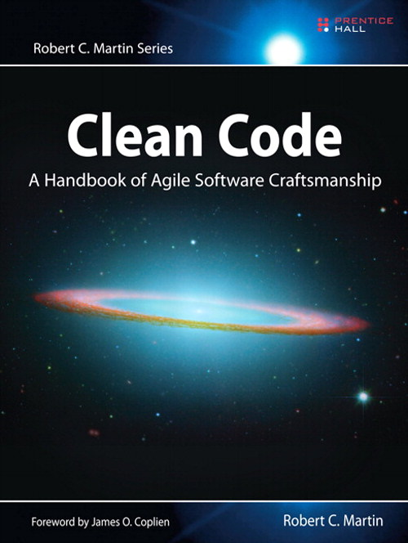

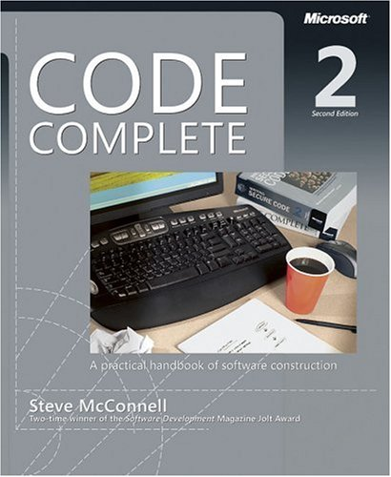
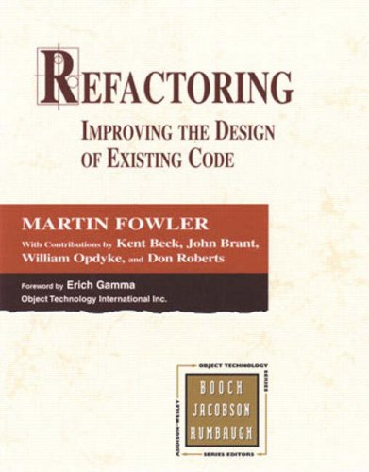
Notes:
Code Complete
Java Style
Implementations patterns
Clean Code
Refactoring
Smalltalk best practices patterns

